Slide 1
Understanding
TNB Charges
22 June 2020
The Following Trademarks Used Herein Are Owned By The Mcdonald's Corporation (USA) And Its Affiliates: Mcdonald's, Golden Arches, Golden Arches Logo, Big Mac.
Notwithstanding The Provisions Of Sections 106 And 106a, The Fair Use Of A Copyrighted Work, Including Such Use By Reproduction In Copies Or Phonorecords Or By Any Other Means Specified By That Section, For Purposes Such As Criticism, Comment, News Reporting, Teaching (Including Multiple Copies For Classroom Use), Scholarship, Or Research, Is Not An Infringement Of Copyright
© 2020 Ibright Great Resources Sdn Bhd
All Rights Reserved

Slide 2
Purpose
Applicable for Commercial Tariff (Tariff C) and Industrial Tariff (Tariff E)
An illustration of how electricity is billed by TNB
  Peak and off-peak use
  Energy
  Demand, Maximum Demand

Slide 3
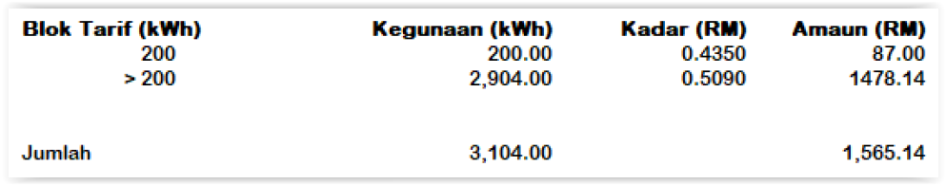
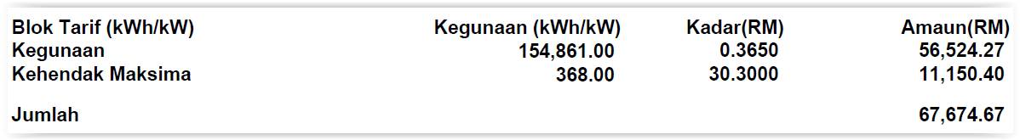
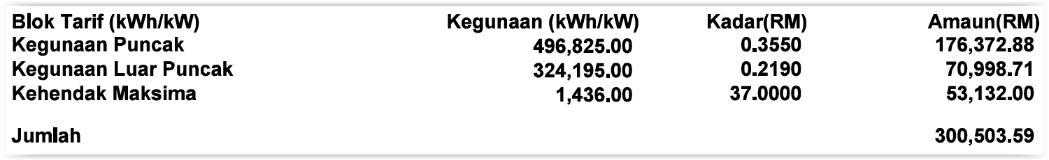
Sample bills
Tariff B
Tariff C1
Tariff E2

Slide 4
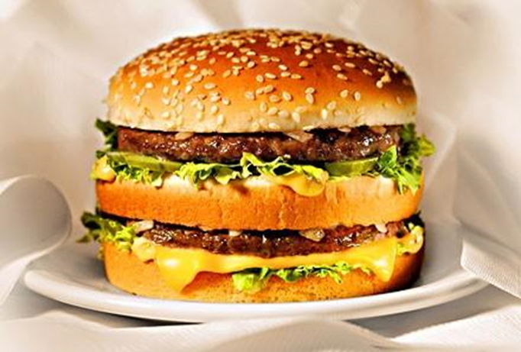
Big Mac
Each Big Mac has 538kcal (calories) as ENERGY
Lets assume this is equivalent to 1kWh of ENERGY
In reality, 538kcal is equivalent to 0.625kWh

Slide 5



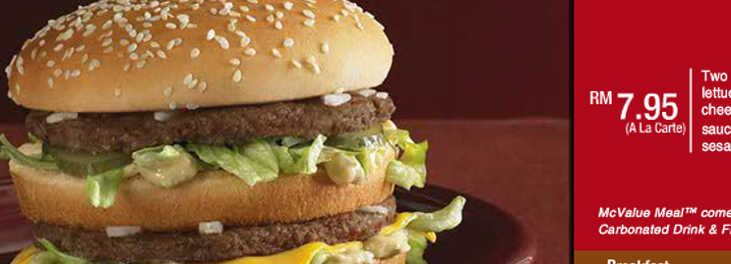
kWh
Pay for the amount of energy used
Reading on Meter:
2454834 - 2439368 = 15466
Pay for the your BIG MAC
Imagine: RM 7.95 for 538kcal of energy

Slide 6
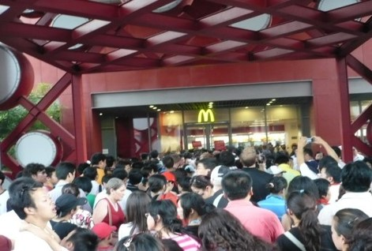
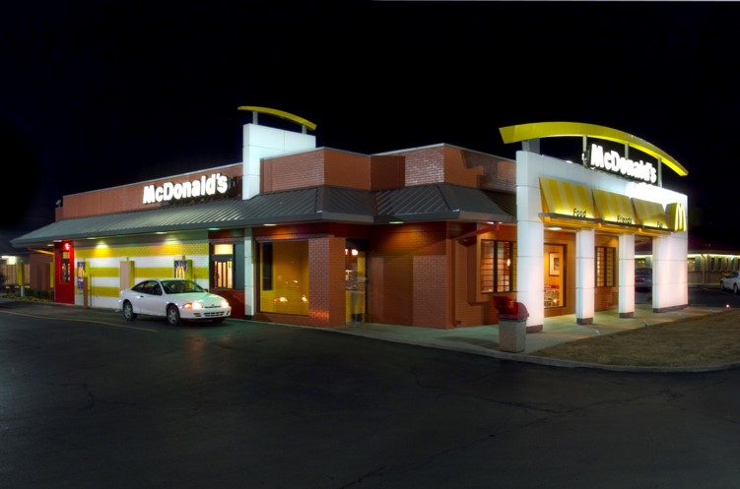
Peak and off peak
PEAK
OFF-PEAK

Slide 7

Peak and Off Peak
Peak hours:
0800hrs till 2200hrs
Off-Peak hours:
0000 hrs till 0800 hrs
2200 hrs till 0000 hrs

Slide 8
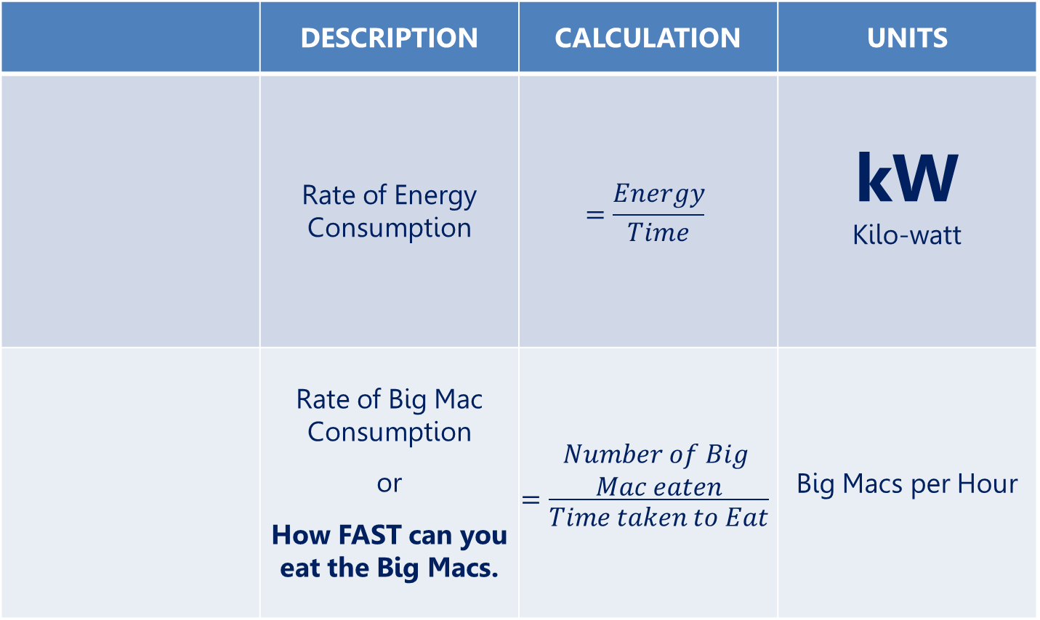
Power

Slide 9
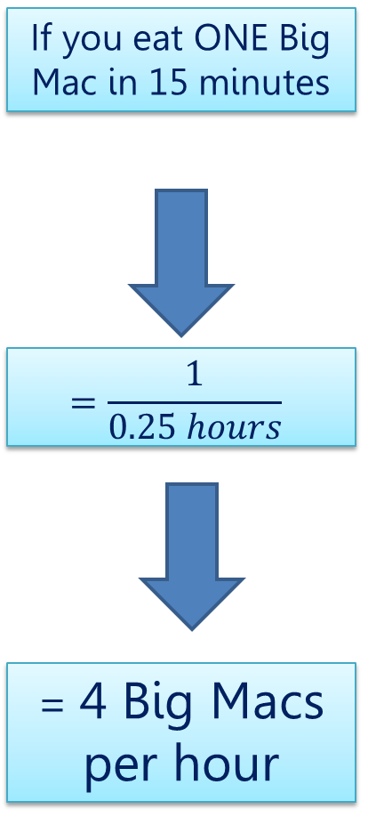
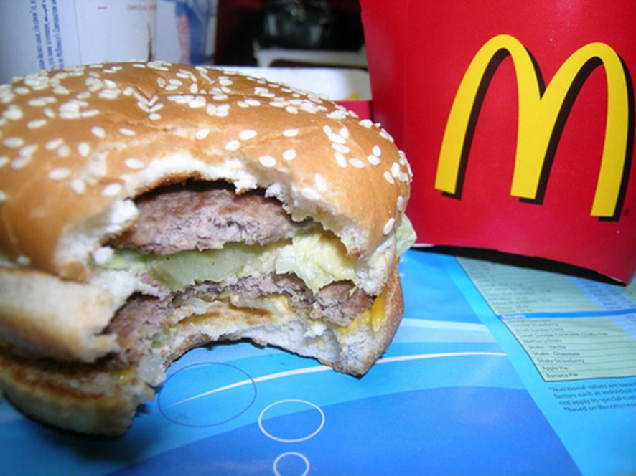
Power

Slide 10
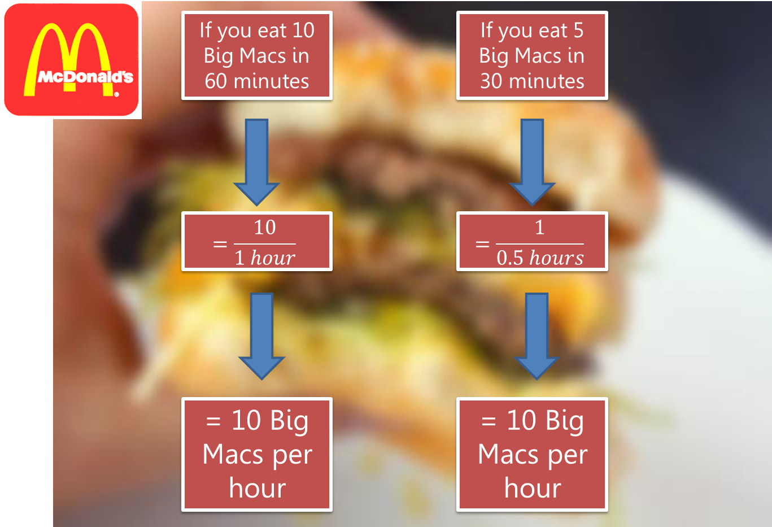
Power: More Examples

Slide 11

Demand
Number of Big Macs you eat calculated based on a fixed 30-minute intervals
Unit: Big Mac per hour
Demand is ONLY calculated during Peak Hours
Power
Amount of Energy consumed in fixed 30-minute intervals
Units: kW (which is kWh per hour)

Slide 12

Demand
Time (fixed 30 mins period) | Number of Big Macs consumed | Demand, Big Macs per hour
0800 till 0830 hrs | 20 | 40
…
2130 till 2200 hrs | 15 | 30
Time (fixed 30 mins period) | Number of kWh (energy) consumed | Demand, kW (kWh per hour)
0800 till 0830 hrs | 20 | 40
…
2130 till 2200 hrs | 15 | 30

Slide 13
The Maximum Demand
The Maximum Demand
Day | Time | Demand
01 Jan 2017 | 0800 – 0830 hrs 0830 – 0900 hrs … 2130 – 2200 hrs | 50kW 60kW … 45kW
…
31 Jan 2017 | 0800 – 0830 hrs 0830 – 0900 hrs … 2130 – 2200 hrs | 51kW 80kW … 30kW
The highest demand recorded by TNB for the month

Slide 14
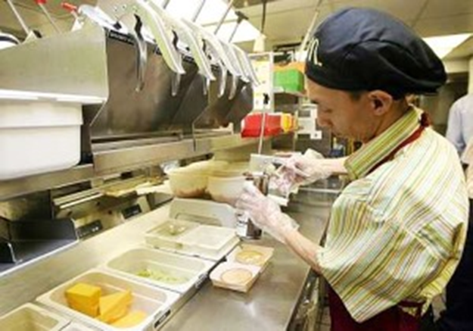
Why Maximum Demand
Imagine:
Once a month, you order 1000 Big Macs per hour.
At other times, you order 500 Big Macs per hour.
Results:
Typically, there will be over & wasted
capacity. (Staff, kitchen size, stock)

Slide 15
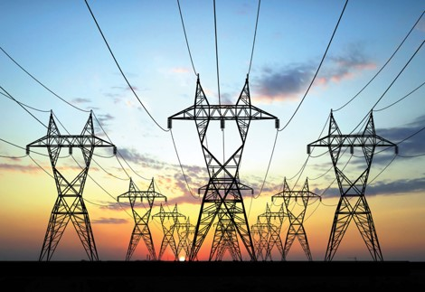
Why Maximum Demand
Imagine:
Once a month, you use 6,400kW
At other times, you use 5,300kW
Results:
Typically, there will be over & wasted
capacity. (Cables, transformers,
generators)

Slide 16

Peak and Off-peak
 | DESCRIPTION
 | Charge more when you use energy during peak hours

Slide 17
Tariff C
Tariff | DESCRIPTION | CALCULATION
C1 | Same charge for peak and off-peak energy usage Cheaper MD Charge | Energy for Peak-hours : RM 0.365 per kWh Energy for Off-Peak : RM 0.365 per kWh Maximum Demand : RM 30.30 per kW
C2 | Cheaper off-peak energy charge VERY expensive MD Charge | Energy for Peak-hours : RM 0.365 per kWh Energy for Off-Peak : RM 0.224 per kWh Maximum Demand : RM 45.10 per kW

Slide 18
Tariff E
Tariff | DESCRIPTION | CALCULATION
E1 | Same charge for peak and off-peak energy usage Cheaper MD Charge | Energy for Peak-hours : RM 0.337 per kWh Energy for Off-Peak : RM 0.337 per kWh Maximum Demand : RM 29.60 per kW
E2 | Cheaper off-peak energy charge Expensive MD Charge | Energy for Peak-hours : RM 0.355 per kWh Energy for Off-Peak : RM 0.219 per kWh Maximum Demand : RM 37.00 per kW

Slide 19
Tariff C
Tariff | DESCRIPTION
C1 or E1 | Good for those: Use a lot of energy during peak Use less during off-peak Can apply for special discount: OPTR - 20% discount for off-peak use
C2 or E2 | Good for those: Using constant or almost constant amount of energy during peak and off-peak period No discount. Way to save is to use more energy during off-peak.

Slide 20
Power Factor
Also called “PF” for short.
Does not have unit, as it is a ‘ratio’.
This is penalty. (If pf drop below 0.85)
Big Mac Example: You order food, but return some of it.
 | DESCRIPTION
 | You order (for example) 100 burgers, but you return 20 burgers.
 | You take energy, but don’t use it. Instead, you return in to TNB. This is called “Reactive Energy”. Units in kVArh

Slide 21
Energy: Active and Reactive
 | Energy | Reactive Energy
Description | You take the energy, you use it. Also known as “real energy” or “active energy”. | You take the energy, but you return it. You take and return 50 times per second.
Units | kWh | kVArh
Equipment | Oven, heaters | Motors, fluorescent lamps (part of it used, part of it returned)

Slide 22
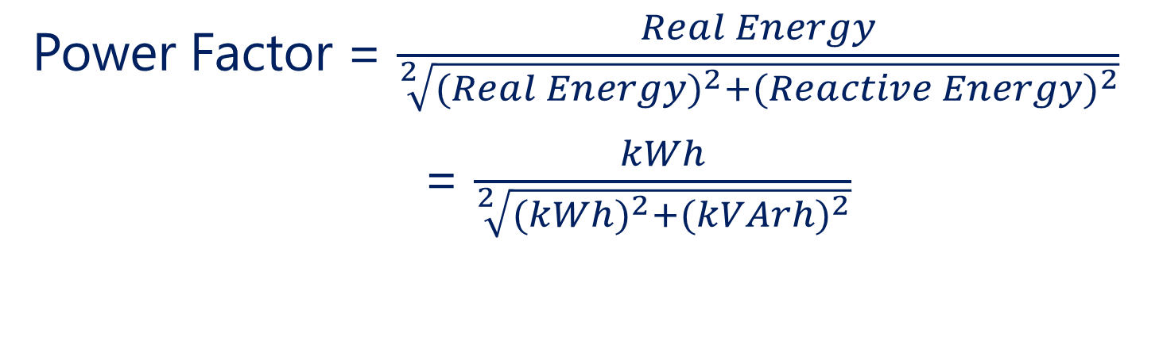
Power Factor
Power Factor = $\frac{Real Energy}{\sqrt[2]{{{(Real Energy)}^{2}+(Reactive Energy)}^{2}}}$
= $\frac{kWh}{\sqrt[2]{{{(kWh)}^{2}+(kVArh)}^{2}}}$
 | DESCRIPTION
 | You can only “return 52%” of your Big Mac before you get a penalty. 52% is based on weight
 | Penalty only if PF is below 0.85 Use Capacitor Banks to keep PF high.

Slide 23
Real Power, Reactive Power, Apparent Power
 | Unit | Analogy
Real Power | kW | The number of Big Macs you eat, per hour.
Reactive Power | kVAr | The number of Big Macs you return, per hour
Apparent Power | kVA | The number of Big Macs you order from the counter, per hour. This includes Big Macs that you will eat and return.

Slide 24
Thank You
To Learn More on Maximum Demand
Visit our website
Ibright.com.my

